Slide 1



UNIVERSITY INSTITUTE OF ENGINEERING
COMPUTER SCIENCE ENGINEERING
Bachelor of Engineering
Design and Analysis of Algorithms(CST-311/ITT-311)
Topic: Linked List
DISCOVER . LEARN . EMPOWER

Slide 2
Learning Objectives & Outcomes
Objective:
To understand the use of linked list and its types
Also understand operation performed on linked list.
Outcome:
Student will understand
Linked list and operation performed on linked list

Slide 3
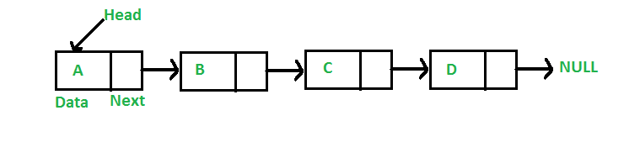
Link List
A linked list is a linear data structure, in which the elements are not stored at contiguous memory locations. The elements in a linked list are linked using pointers as shown in the below image:

Slide 4
Representation
A linked list is represented by a pointer to the first node of the linked list. The first node is called the head. If the linked list is empty, then the value of the head is NULL.
Each node in a list consists of at least two parts:
  1) data
  2) Pointer (Or Reference) to the next node

Slide 5
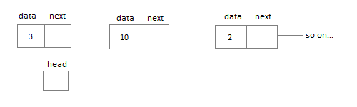
Singly Linked List
Singly linked lists contain nodes which have a data part as well as an address part i.e. next, which points to the next node in the sequence of nodes.
The operations we can perform on singly linked lists are insertion, deletion and traversal.

Slide 6
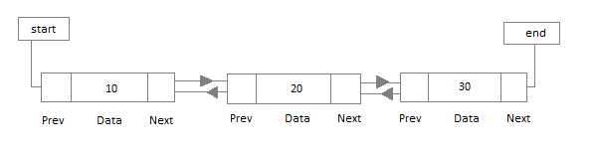
Doubly Linked List
In a doubly linked list, each node contains a data part and two addresses, one for the previous node and one for the next node.

Slide 7
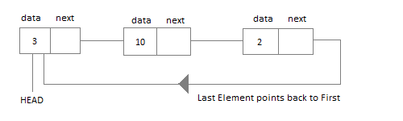
Circular Linked List
In circular linked list the last node of the list holds the address of the first node hence forming a circular chain

Slide 8
REFERENCES
Text books:
Cormen, Leiserson, Rivest, Stein, “Introduction to Algorithms”, Prentice Hall of India, 3rd edition 2012. problem, Graph coloring.
Horowitz, Sahni and Rajasekaran, “Fundamentals of ComputerAlgorithms”, University Press (India), 2nd edition
Websites:
https://www.geeksforgeeks.org/data-structures/linked-list/

Slide 9
Summary
Introduction to Link List
  Representation
  Types of Link List
  Single LL
  Double LL
  Circular LL

Slide 10
THANK YOU

